Slide 1
Living JEA, Part 2: How to survive under JEA control
Evgenij Smirnov
Notes:
This is the slide shown before the presentation starts. When you are ready to go, tell the video operator to start the recording, and click to the next slide.

Slide 2
5
Video operator, did you start the recording?
Notes:
[REQUIRED SLIDE]
These slides are mandatory and help us with video post-processing. Please keep them as they are.

Slide 3
4
Notes:
[REQUIRED SLIDE]

Slide 4
3
Notes:
[REQUIRED SLIDE]

Slide 5
2
Notes:
[REQUIRED SLIDE]

Slide 6
1
Notes:
[REQUIRED SLIDE]

Slide 7
Living JEA, Part 2: How to survive under JEA control
Evgenij Smirnov
Notes:
This is your opening. Now the stage is yours!

Slide 8
This Session
prepare for the inevitable
take a fresh look at your PowerShell code
communicate your findings
make your organization‘s JEA implementation even better!
Notes:
Please invest some time to reconsider your session: what is it that audience can get out of it? Try and be as precise as you can. If you are showing solutions, then focus on “how to”. If you present about a general technology, you’ll want to stick to “Be able to” or “Understand why/how”.

Slide 9
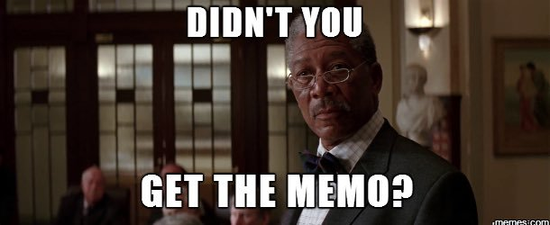
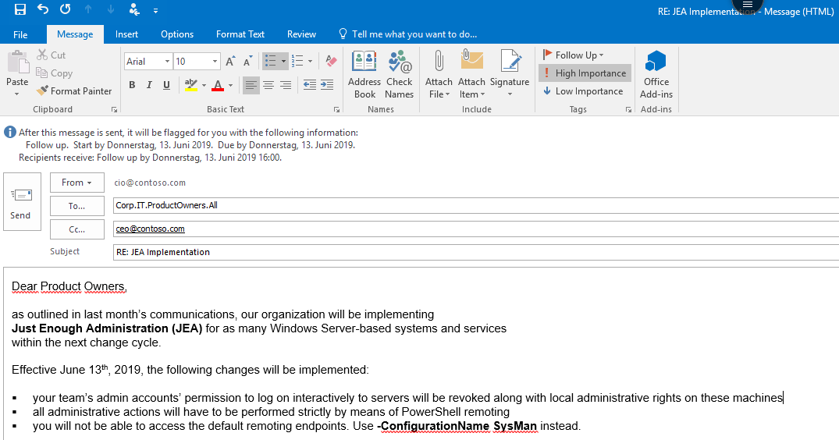
The day before Day One…

Slide 10



Prepare for the inevitable
Not being able to execute admin rights over RDP or RPC
Not being able to connect to the default endpoint
Adjusting to working with Run-As-Accounts
Possible double-hop authentication issues
Not finding all cmdlets, functions and parameters
Unexpected WinRM restarts on targets
Dealing with restricted language mode

Slide 11


Connecting to named endpoints #1
before:
after:

Slide 12
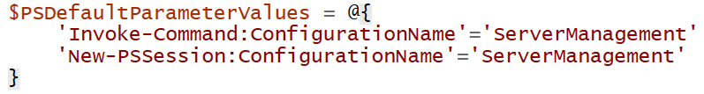
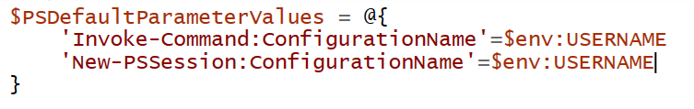
Connecting to named endpoints #2
Canonical delivery model:
User-centric delivery model:
Obviously won‘t work in a role-centric delivery model

Slide 13
Connecting to named endpoints #3
Beware of Enter-PSSession
An interactive PSSession requires a number of cmdets which may be missing in a constrained endpoint
New-PSSession and Import-PSSession can help here
Use -Prefix to separate remote from local

Slide 14
Locating possible remoting Cmdlets
Setting named endpoint as default

Slide 15
Catching missing Cmdlets and arguments
Check for Cmdlets and parameters prior to execution
Missing modules → use #requires primitive if submitting a whole script
Fully qualified module checking can also be a good idea, security-wise
AST can help checking the entire script
Catching exception is trickier
…but can help in scenarios where performance is an issue
Using trap allows for targeted checking and automated feedback

Slide 16
Checking for command availability
Catching exceptions globally

Slide 17
Working with RunAs-Accounts #1
In local access scenarios:
You cannot assign granular permissions to virtual accounts directly so may need to create groups
If no groups are specified, virtual accounts become local admin (think remoting to a DC ;-) )
In remote access scenarios:
RunAs-Accounts may not have enough permissions to external resources if they‘re virtual
BUT can help overcome Double-Hop authentication problems without resorting to Kerberos delegation

Slide 18
Working with RunAs-Accounts #2
In any scenario:
Monitoring, Threat Detection etc. have no ability to identify the actual caller
Using virtual accounts, there are limited posibilities (need to parse the user name, SID won‘t be of help ;-) )

Slide 19
Working with RunAs-Accounts

Slide 20

WinRM service restarts
In interactive sessions, it will be quite irritating but usually not very dangerous, unless you really needed those results and it‘s nearing 5 p.m.
In scripts, on the other hand…
You need to deal with this explicitly in your scripts!

Slide 21
Dealing with WinRM restarts and session disconnections

Slide 22
# Follow these instructions to show perfectly color-coded PowerShell code.
# Paste code to PowerShell ISE, select it, and copy it to the clipboard.
Paste-Code -ToISE | Select-Code | Copy-ToClipboard
# To insert it with full color-coding, paste the code into your slide.
# It will be black, and there is a toolbutton labelled (Ctrl) in PPT.
Click-ToolButton -Choose SymbolWithClipboardAndBrush
# Click the toolbutton, and choose the button that shows a clipboard with a brush.
# This will add color-coding back to the pasted code
PLEASE NOTE: You do not need to use PowerShell ISE to code, or to demo.
Use your preferred editor. With a light theme.
These steps use PowerShell ISE to color-code your code correctly and consistently, and insert the color-coded code into the slide. Please help make all code look consistent. Many thanks!
This is an example of the “Code” layout.
Notes:
To color-code PowerShell code in a consistent way, we ask that you paste your code into PowerShell ISE, select it, and copy it from ISE. Next, paste the code into the text field. It will appear black at first. When you click the small tool button that appears after pasting the code, choose the middle icon with the brush. This adds back the token colors.
Again, use any editor you want during your demos. We ask that you use ISE solely for the purpose of consistently color-coding.
If you use editors other than ISE, make sure you choose a light theme. Dark themes are hard to watch in a presentation room.

Slide 23
Summary
JEA poses challenges that may be easy to overcome but still require a fair amount of work
Try to view this as a chance to have another look at your code and maybe implement some best practices in the process
Scripts that run within a JEA-controlled environment will become more and more robust over time
Feedback about prohibitive limitations can be automated
Now go grab some lunch! If you have any questions, I’ll be around for the rest of the day ☺ or hit me up on Twitter
Notes:
Sum up your key messages

Slide 24
Notes:
[REQUIRED SLIDE]
Make sure you provide all materials that audience needs to reproduce your demos.
Either upload them as a PowerShell module to www.powershellgallery.com (preferred for reusable functions)
Or, upload them to our github repository (ask the girls at the info desk to provide you with access)
Or, upload them to your own github repository
Please make sure all materials are available by the time your presentation starts, or at minimum upload them right after your presentation

Slide 25
Notes:
[REQUIRED SLIDE]
If you sticked to your timing, you now have 15 min left for Q&A. If you missed your timing, you will have to leave the room when your slot is over. In this case, invite your audience to the coffee break and offer to cover questions there.
IN ANY CASE please point your audience to the conference app and the session voting. By the time the conference opens, the eventraft app *should* have the option to vote on sessions.
Please MAKE SURE you leave your room when your slot is over. The next speaker would like to set him/herself up and get everything up and running.

Slide 26
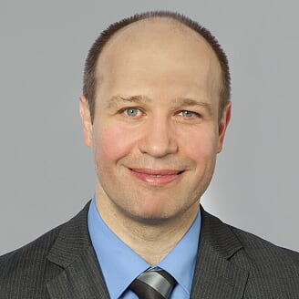
about_Speaker
Id: cj_berlin
DisplayName: Evgenij Smirnov
LocationBase: Berlin (DE)
Languages: {DE,EN,RU}
InfoURL: http://evgenij.smirnov.de
BlogURL: https://it-pro-berlin.de
EmployedAt: msg services ag
UserGroups: {“Windows Server User Group Berlin”,”Exchange User Group Berlin”}
Notes:
Do not EVER discuss this slide during your presentation. Please do not take presentation time to talk about yourself more than just a few introductory sentences. Instead, invite interested audience to the coffee break, and then talk about yourself, your job, your services, etc.
Use this slide to sum up your details. It will be part of the conference materials and recorded videos.

